Slide 1

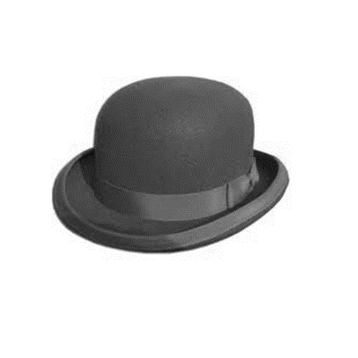

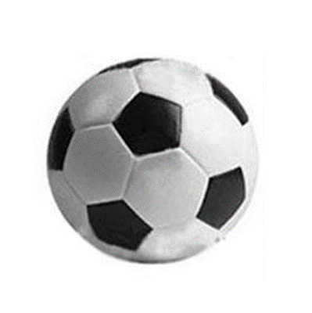


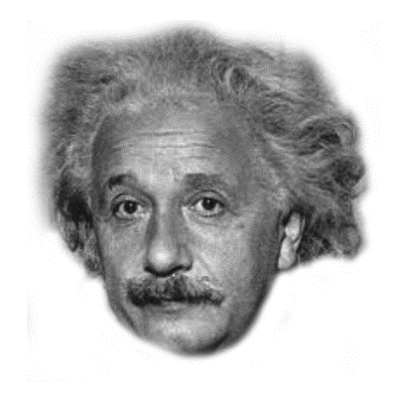

(1) Training
(2) Selective retrieval
(3) Final visual
recognition test
Targets
Competitors
sand
sand
sand
sand
F O S ?
4 s
Baseline
antique
antique
X 2
X 1
Not cued during
this phase
Practice visual recognition test

